Slide 1
Color Pallet and Logos

Slide 2
Color Palette
Primary Colors
R: 255
G: 196
B: 12
R: 0
G: 0
B: 0
Secondary Colors
R: 0
G: 94
B: 170
R: 0
G: 171
B: 188
R: 101
G: 138
B: 134
R: 206
G: 137
B: 20
R: 177
G: 34
B: 22
R: 92
G: 115
B: 21
R: 119
G: 100
B: 65
R: 174
G: 165
B: 122

Slide 3












Logos
ENTERPRISE LOGOS
BUSINESS UNIT LOGOS
ENTERPRISE LOGOS WITH TAGLINE
BUSINESS UNIT LOGOS WITH TAGLINE

Slide 4






Logos
BRAFASCO LOGOS
KENSEAL LOGOS

Slide 5
Iconography

Slide 6



















































































































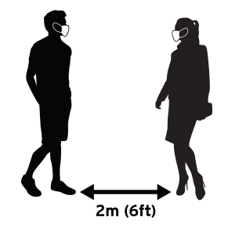













White Cap Iconography
GENERIC SYMBOLS
BUSINESS STRATEGY
LOCATIONS
NOTES & PLANS
FINANCIAL
DIGITAL DEVICES
CLOUD
CALENDAR
WEATHER & SEASONS
MISC.
CONTRACTORS & HARD HATS
COVID-19
PRINT
AWARDS

Slide 7



























































































































White Cap Iconography
COMMODITIES
SAFETY
TOOLS
SUPPLY CHAIN
TRANSPORTATION & CRANES
ON THE ROAD
PEOPLE
MISCELLANEOUS
SOCIAL MEDIA

